Slide 1

Technical Documentation

Slide 2
Today’s Agenda
Wireframes Design
Frontend Wireframes
Schema Design

Slide 3
Wireframe Design
What is the purpose of Wireframe Design involving login?
Wireframe Design allows login users to login with their current account or if they don’t have an account, they be able to create one with using their work or personal email and password.

Slide 4
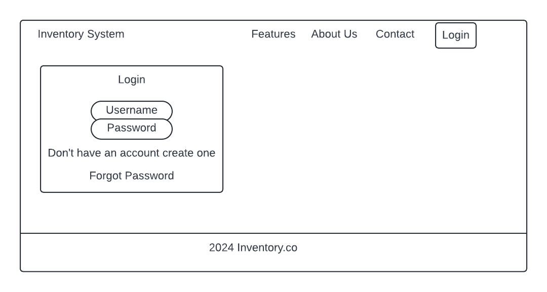

Slide 5
What’s in the registration signup form?
It will have username and password to verify the user on whoever is trying to log in with your FirstName and Last Name as well in the signup form.
Password is important to make sure your account is saved with username when creating an account.
FirstName and Last Name is to make sure when you create account and make sure that is you.

Slide 6
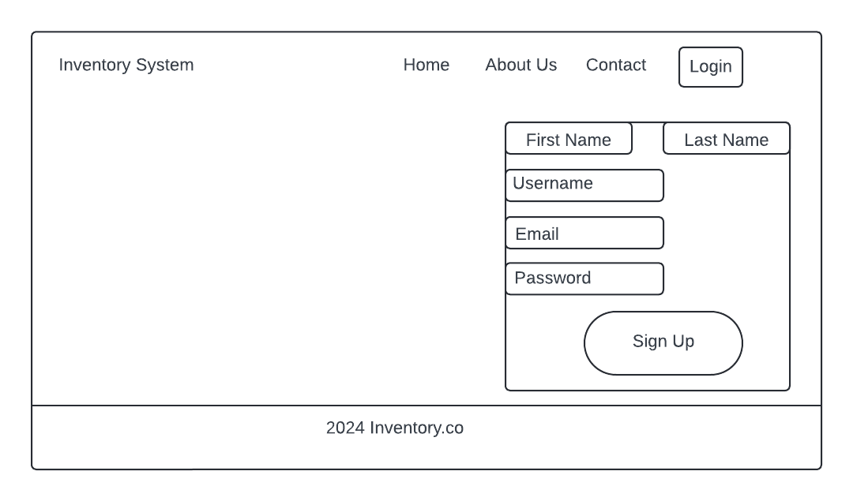

Slide 7
Front-end Wireframes
What is the purpose and features for front-end wireframes?
Visualization of Layout: Wireframes help visualize the placement of elements like input fields, buttons, and labels, ensuring a logical and intuitive structure.
Improved User Flow: They provide an overview of how users will interact with the page to complete registration.
Feedback and Iteration: Wireframes serve as a tool for gathering feedback early in the design process before any code is written.
Collaboration Tool: They allow designers, developers, and stakeholders to align on the UI and functionality.
Efficiency: Simplifies development by providing a clear blueprint for developers.
A "Login" link for users who already have an account.
A "Forgot Password" link.

Slide 8
Form Input Fields:
Name: Includes first and last name fields.
Email Address: Field for user identification and verification.
Password: Fields for setting and confirming a password.
Optional Fields: E.g., phone number or address, if needed.
Validation Indicators:
Mark fields that are required.
Indicators for password strength or invalid email format.
Submit Button:
Primary button for submitting the form.
Error Messages:
Placeholder elements to show real-time validation errors.
Notifications for missing or incorrect input.
Additional Links:
A "Login" link for users who already have an account.
A "Forgot Password" link

Slide 9
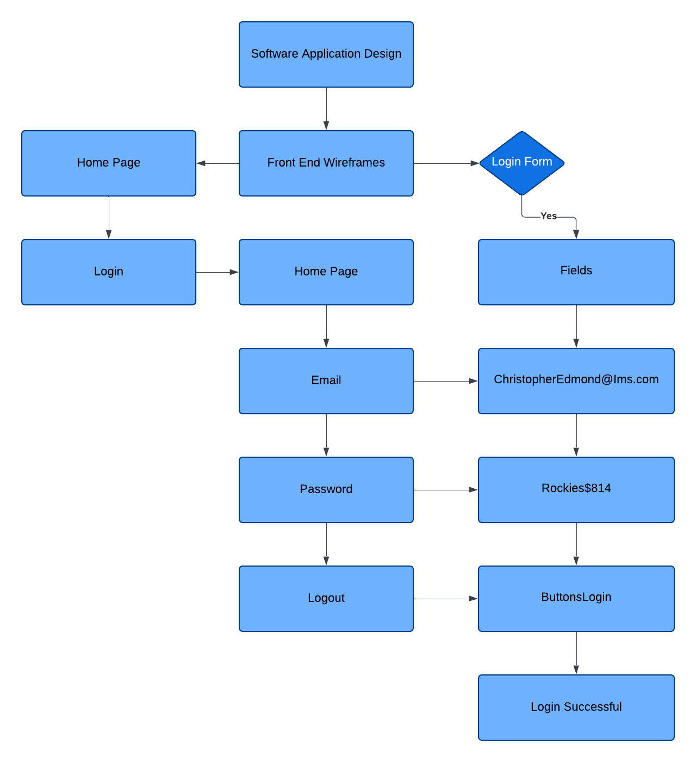

Slide 10

Schema Design
In a database for an e-commerce platform:
Tables: Users, Products, Orders
Fields in Users: user_id (primary key), name, email
Relationships:
Users can place many Orders (one-to-many).
Each Order can include many Products (many-to-many, often resolved with a junction table like Order Details).
Schema design is a foundational step in creating any functional and effective database system, whether for small-scale applications or enterprise-level systems

Slide 11
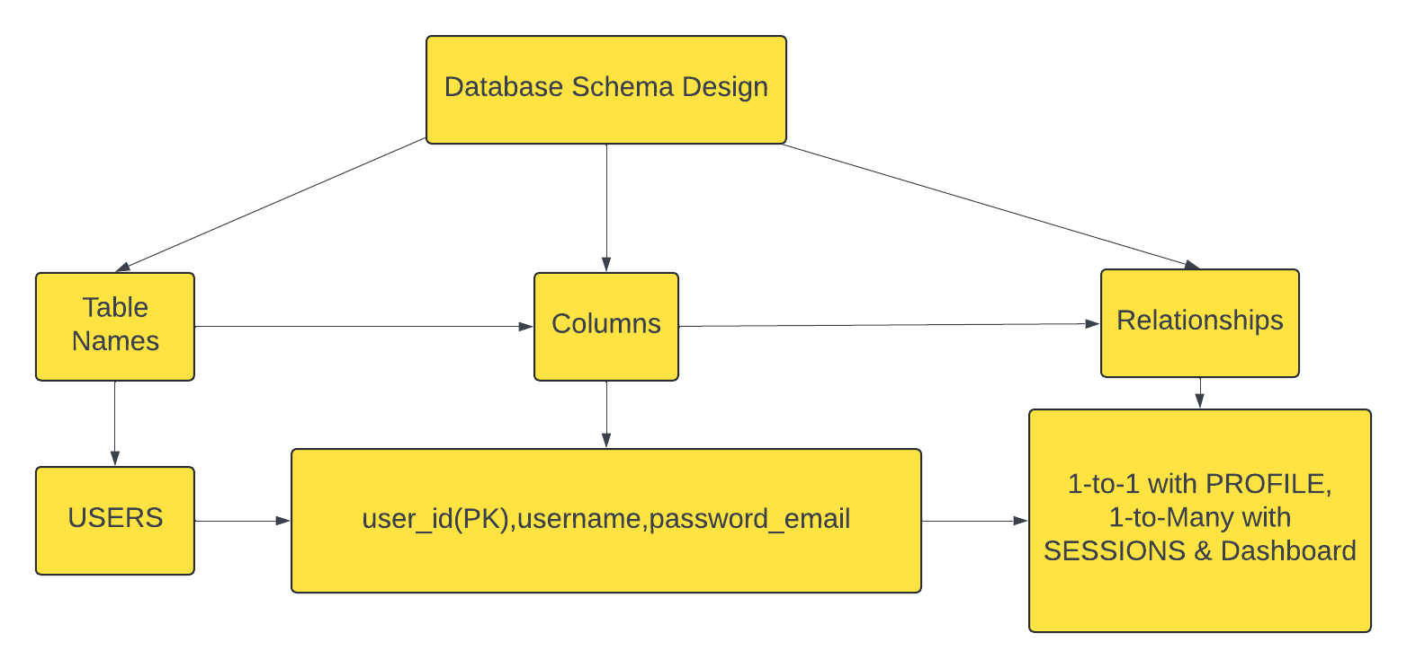

Slide 12

Thank you
For participle in the video presentation stay tuned for part 2.

